Slide 1


REACT
ESSENTIALS
MARCH 15 & MARCH 22
2026
TWO DAY REACT WORKSHOP

Slide 2
REACT WORKSHOP
REACT ESSENTIALS:
BUILDING INTERACTIVE WEB APPLICATIONS WITH APIs
First City Providential College
WORKSHOP OUTLINE
I
Frontend Development
~2 HOURS
ACTIVITY
EST. DURATION
1
Environment Setup for FRONTEND
~20 min
Installation of Node JS & Node Package Manager (NPM)
React App Creation (using Vite)
2
Introduction to React
~25 min
Project Structure
Tour of the different files & folders
Folder Organization
Hands-on coding, basic syntax, JSX (TSX) overview
3
Understanding the Concept of Components
~20 min
How to create & use components
Using props in components
4
Interactivity on React Websites
~35 min
Fundamentals for event handling
Introduction to React Hooks
Handling states and mutating them using useState
Conditional rendering
Uses for useEffect
Other React Hooks
5
The Concept of SPA – Navigating Around using React Router
~10 min
6
Getting Inputs with Forms
~10 min
☕
SHORT BREAK
~15 min
Refreshments · Restroom · Informal Q&A

Slide 3
REACT WORKSHOP
REACT ESSENTIALS:
BUILDING INTERACTIVE WEB APPLICATIONS WITH APIs
First City Providential College
WORKSHOP OUTLINE
II
Backend Development
~2 HOURS
ACTIVITY
EST. DURATION
1
Environment Setup for BACKEND
~15 min
2
Backend Fundamentals (& Concepts)
~35 min
APIs and RESTful Endpoints
Different HTTP Requests (GET, POST, PUT, DELETE)
Handling loading states, errors, and JSON responses
3
Introduction to Authentication
~25 min
Stateless authentication using JWT
Protected Routes
4
Database Integration
~25 min
Connecting to a database (PostgreSQL / MongoDB)
CRUD operations with an ORM / ODM
Schema design fundamentals
5
Wrap-Up & Q&A
~20 min
Key takeaways & recap
Open floor Q&A
Resources & next steps

Slide 4

REACT WORKSHOP
REACT ESSENTIALS:
BUILDING INTERACTIVE WEB APPLICATIONS WITH APIs
First City Providential College
ENVIRONMENT SETUP
MINIMUM SYSTEM REQUIREMENTS
Here are the minimum system requirements:
At least 8 GB of RAM
Substantial amount of Storage
Substantial CPU
INSTALLED APPLICATIONS:
Node JS - https://nodejs.org/en/download
Preferred Text Editor (i.e. Sublime Text, VS Code, etc.)
Preferred Browser (i.e. Google Chrome, Firefox, etc.)
Optionally:
Docker for Windows - https://www.docker.com/
Git - https://git-scm.com/install/windows
DAY 1

Slide 5
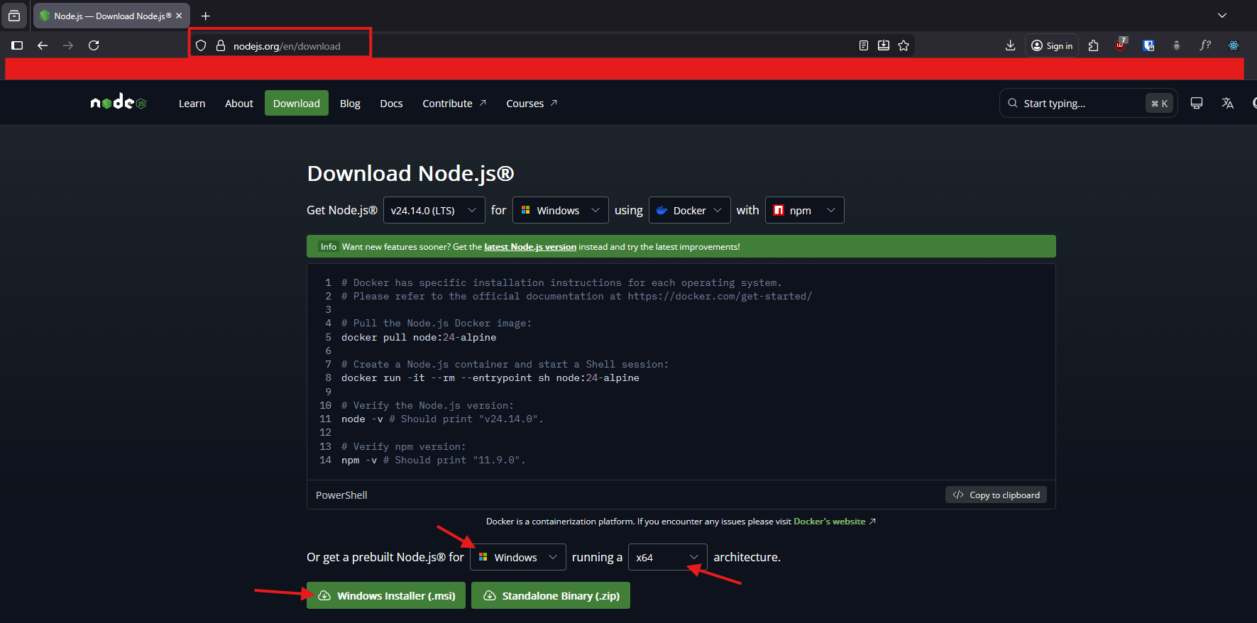
REACT WORKSHOP
REACT ESSENTIALS:
BUILDING INTERACTIVE WEB APPLICATIONS WITH APIs
First City Providential College
ENVIRONMENT SETUP
INSTALLATION
Go to https://nodejs.org/en/download
Select your OS and your Architecture
Click on the Installer Download button
Follow the installation instruction
Tip: To verify successful installation, run in the terminal node -v and npm -v
DAY 1

Slide 6
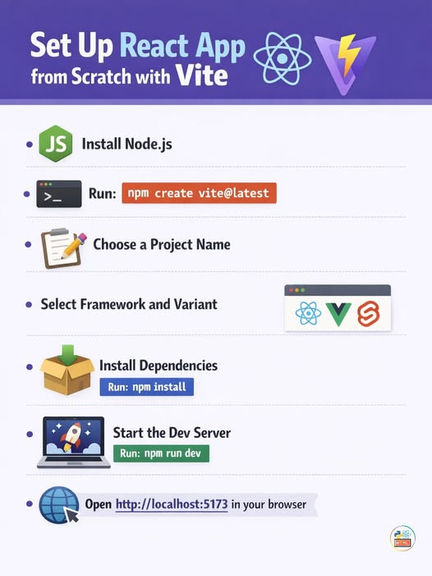
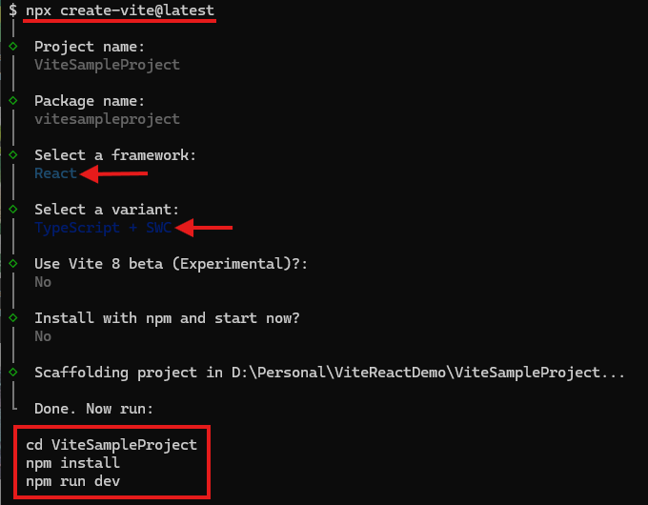
REACT WORKSHOP
REACT ESSENTIALS:
BUILDING INTERACTIVE WEB APPLICATIONS WITH APIs
First City Providential College
ENVIRONMENT SETUP
CREATING YOUR FIRST
REACT PROJECT
Run npx create-vite@latest command in your terminal
Name your First Project
Name your Package (or just press Enter to skip it)
Select your preferred variant (Recommended: Typescript + SWC)
DON’T use Vite 8 beta
You can optionally skip installation and start (Recommended: No)
Credits to: Coding with Parvez
DAY 1

Slide 7
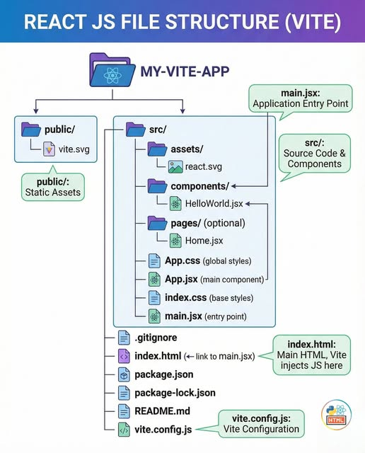
REACT WORKSHOP
REACT ESSENTIALS:
BUILDING INTERACTIVE WEB APPLICATIONS WITH APIs
First City Providential College
ENVIRONMENT SETUP
PROJECT FOLDER STRUCTURE
components/ - contains your React Components
pages/ - stores your Pages
assets/ - contains all your images and other file formats (i.e. Font Files)
Note: This is what typically project folder look like on small / micro sites (i.e. Personal Websites, etc.)
DAY 1
Credits to: Coding with Parvez

Slide 8
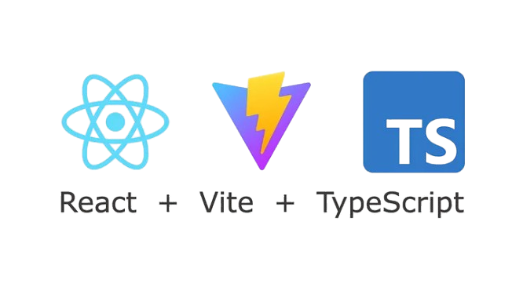
REACT WORKSHOP
REACT ESSENTIALS:
BUILDING INTERACTIVE WEB APPLICATIONS WITH APIs
First City Providential College
HANDS-ON REACT APPLICATION
CODE WORKSHOP (FRONTEND) – DAY 1
Pre-requisites:
Knows HTMLS / CSS / JavaScript
Familiar with TypeScript
Tools
Any preferred Text/Code Editors (e.g. VS Code [RECOMMENDED], Notepad++, Neovim, etc.)
Node JS & Node Package Manager (NPM)
Terminal (e.g. Gitbash, etc.)
Note: most developers use Node Version Manager (NVM) to install Node JS & Node Package Manager.
DAY 1

Slide 9
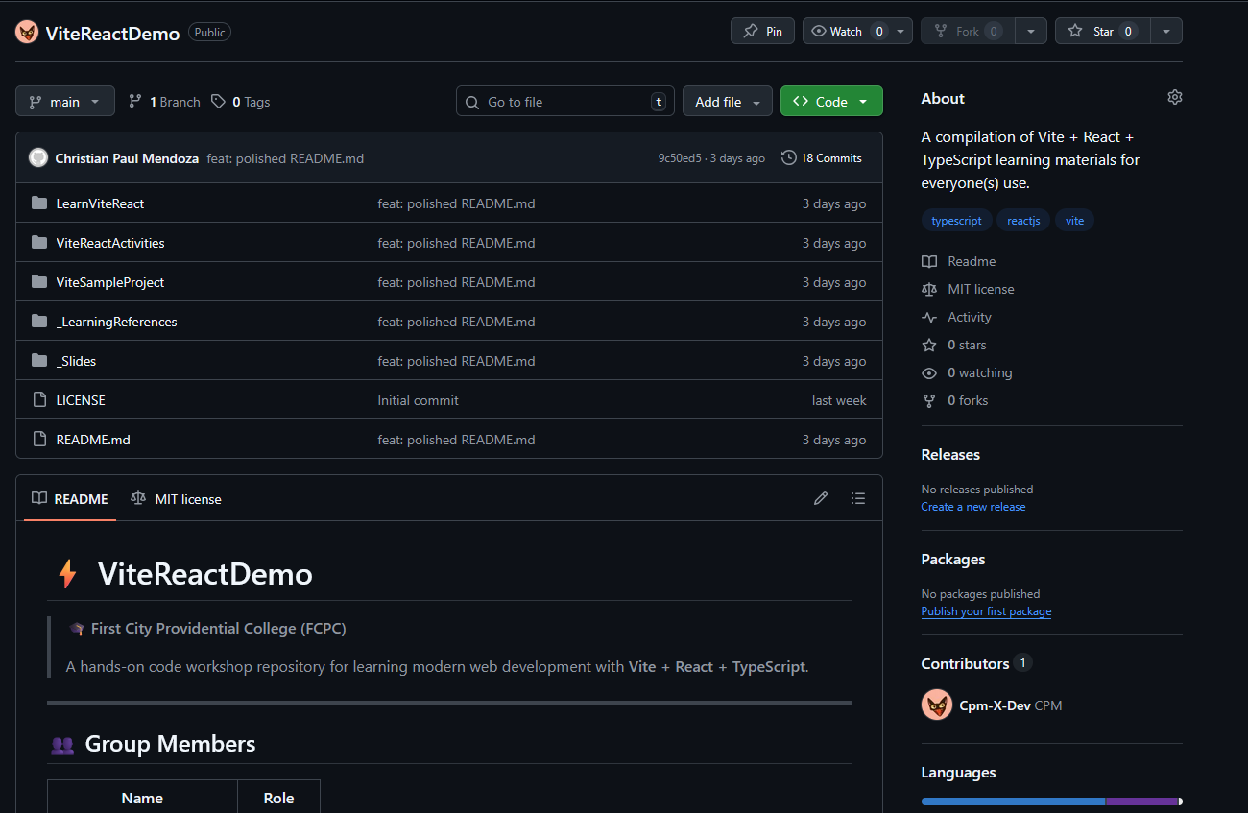
REACT WORKSHOP
REACT ESSENTIALS:
BUILDING INTERACTIVE WEB APPLICATIONS WITH APIs
First City Providential College
HANDS-ON REACT APPLICATION
CODE WORKSHOP (FRONTEND) – DAY 1
Please do note that our activity is open and free to download. Everything you need will be in this github repository:
https://github.com/Cpm-X-Dev/ViteReactDemo
Clone command:
git clone https://github.com/Cpm-X-Dev/ViteReactDemo.git
DAY 1

